Slide 1
Understanding Private Clouds

Slide 2
Private Clouds
A “cloud” within a private environment or network
Delivers the benefits of cloud computing without pitfalls like
Data security
Corporate governance
Reliability concerns
Useful if there already a big hardware investment
Criticism: Users "still have to buy, build, and manage them" and as such do not benefit from lower up-front capital costs and less hands-on management.
Advantage: Build a charge-back system for infrastructure shared across departments.

Slide 3
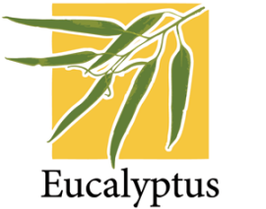

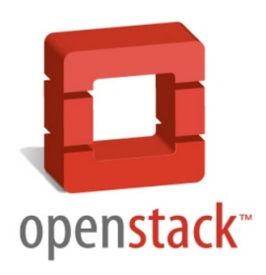

Private Clouds – Main Players

Slide 4
Eucalyptus
Most popular “open source” IaaS cloud computing platfom
Almost compatible with Amazon Web Services (AWS)
Supports Vmware, Xen and KVM
Extremely flexible and easy to administer
25,000 clouds around the world are powered by Eucalyptus
Try the community cloud for free: http://open.eucalyptus.com/try/community-cloud

Slide 5
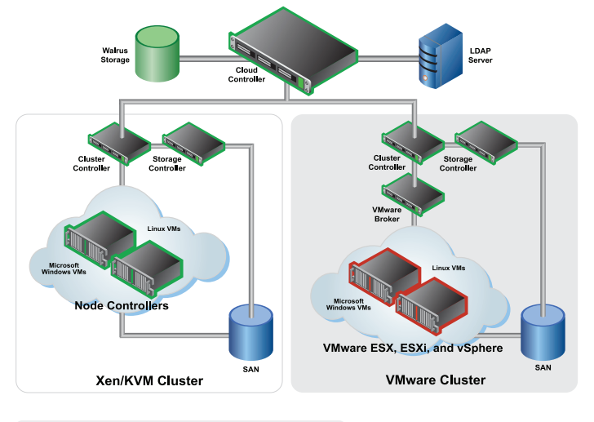
Eucalyptus

Slide 6
Cloud.com (CloudStack)
Converts fully virtualized servers into a Infrastructure as a service.
Provides orchestration of virtualized resources into one homogenous environment.
Cross Hypervisor support – run multiple hypervisors in the same cloud
Support for Open Source Hypervisors – XEN, KVM as well as enterprise level – Vmware and Xenserver
Easy to Use & customizable Web Interface
Powerful API
Dynamic Workload Management

Slide 7
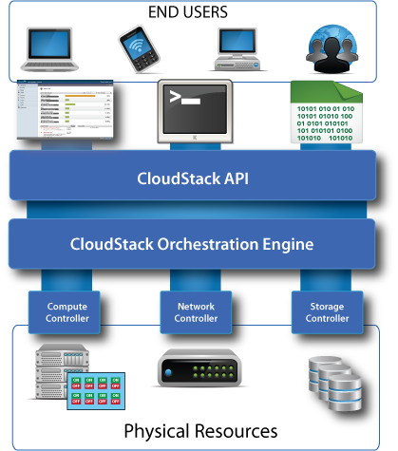
Cloud.com

Slide 8
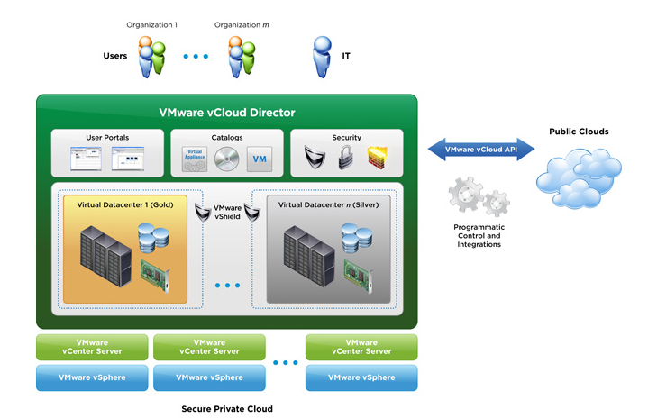
Vmware’s vCloud Director

Slide 9
OpenStack
IaaS cloud computing project by Rackspace Cloud and NASA.
Currently more than 100 companies have joined the project among which are Citrix Systems, Dell, AMD, Intel, Canonical, and Cisco
Completely open source as opposed to Eucalyptus and Cloud.com
It currently encompasses 3 projects:
Swift : Object/blob storage
Glance : discovery, storage and retrieval of virtual machine images
Nova: Provide virtual servers on demand.
Stackops : www.stackops.com provides a easy way to install/setup Openstack environment

